Slide 1
Improving RL Agent for Dilution (Part 5 – Closer Look at Data)
May 18

Slide 2
12 Treg Donor Data Visualized (Part 2)
Fold expansion (cell concentration)
Fold increase factor

Slide 3
Clustering
Identify groups of data (in our case: donors) that share similar characteristics
K-means clustering (left)
Initialize centroids
Calculate distance to nearest centroid
Calculate new centroid location
Iterate
DBSCAN
EM GMM
https://towardsdatascience.com/the-5-clustering-algorithms-data-scientists-need-to-know-a36d136ef68

Slide 4
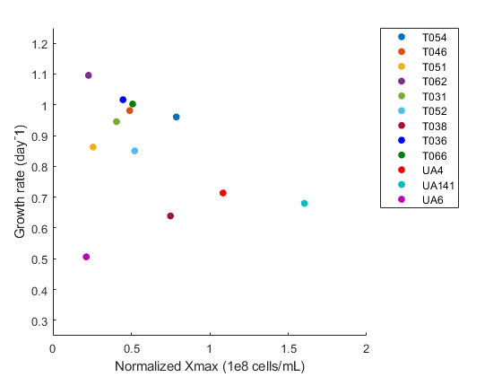
Input data: logistic model parameters
Normalized Xmax
Normalized Growth rate

Slide 5
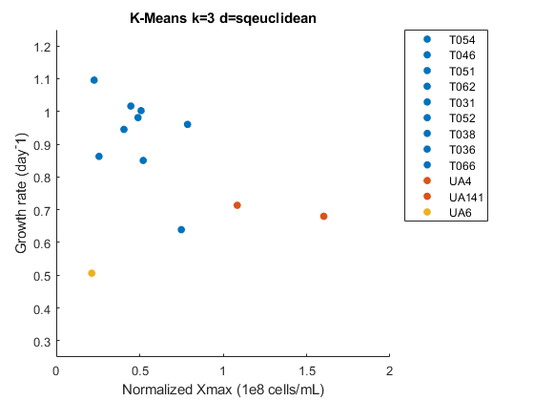
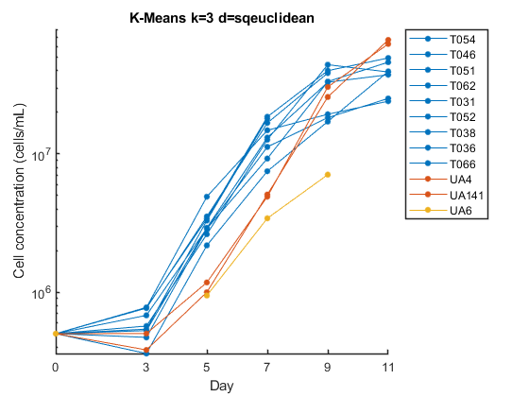
K-means k=3
1
1
1
1
1
1
1
1
1
2
2
3

Slide 6
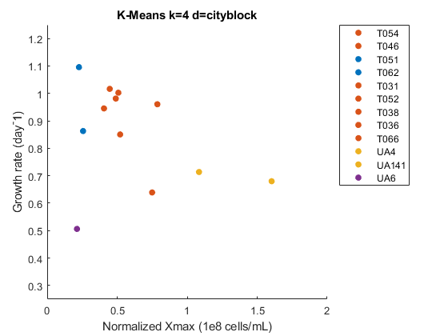
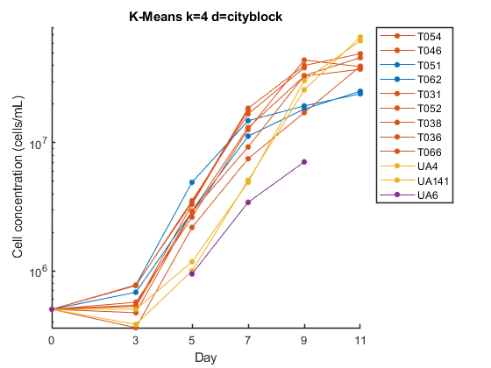
K-means k=4
2
2
1
1
2
2
2
2
2
3
3
4

Slide 7
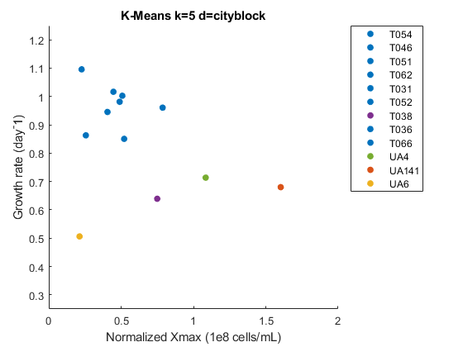
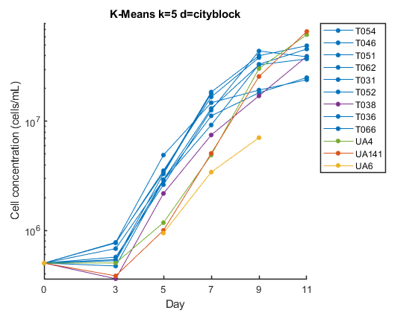
K-means k=5
1
1
1
1
1
1
4
1
1
5
2
3

Slide 8
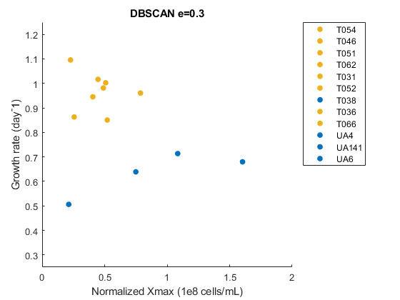
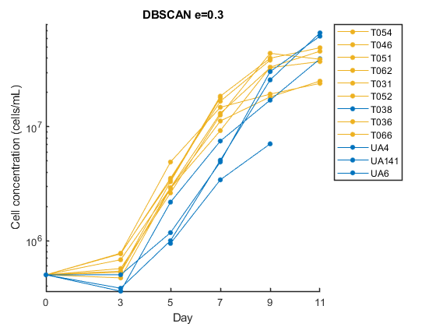
DBSCAN
3
3
3
3
3
3
1
3
3
1
1
1

Slide 9
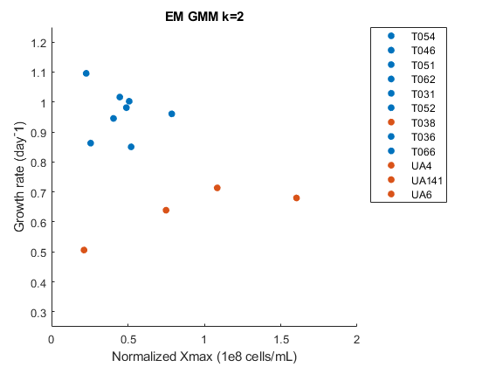
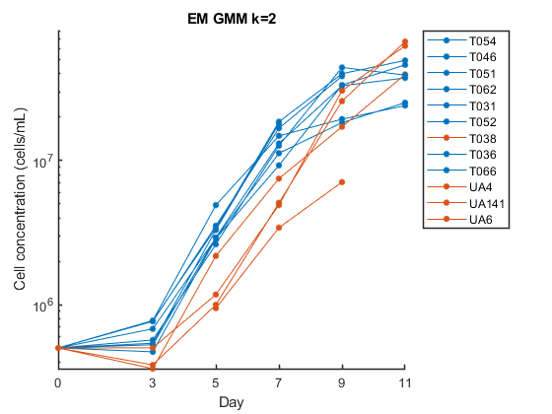
EM GMM k=2
1
1
1
1
1
1
2
1
1
2
2
2

Slide 10
Now we have an idea of what donor clusters exist in our data set
Problem: cannot predict donor cluster of new donor without data all the day up to day 11

Slide 11
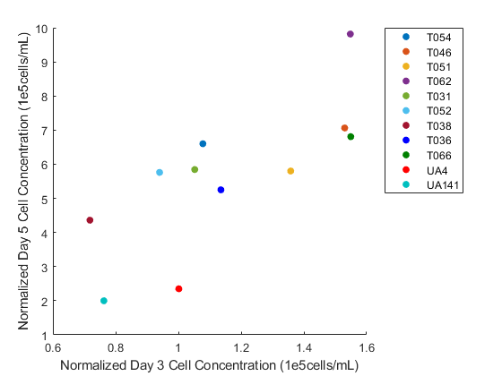
Input data: day 3 and day 5 data
Normalized day 3 cell concentration
Normalized day 5 cell concentration

Slide 12
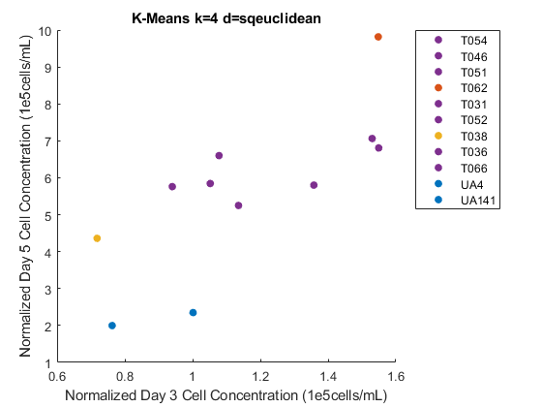
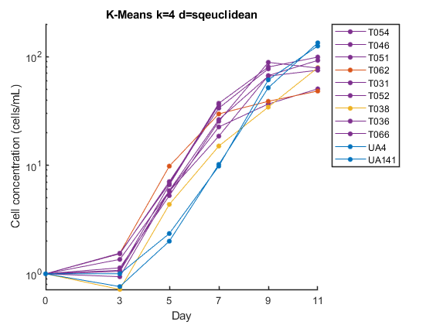
K-means k=4
4
4
4
2
4
4
3
4
4
1
1
2

Slide 13
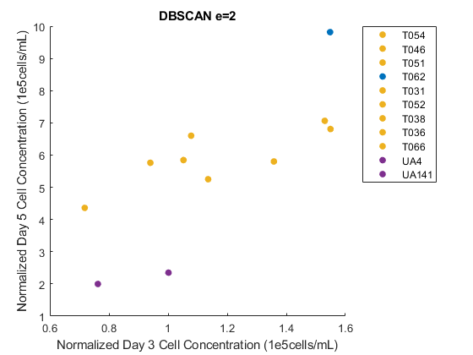
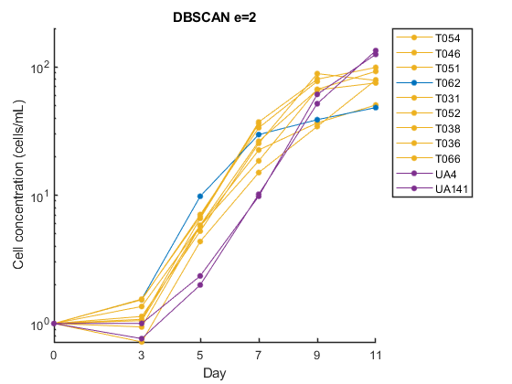
DBSCAN
3
3
3
1
3
3
3
3
3
4
4
2

Slide 14
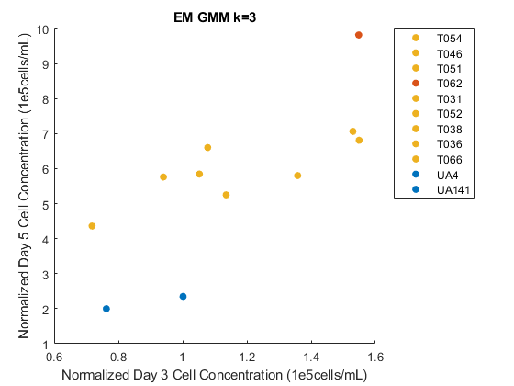
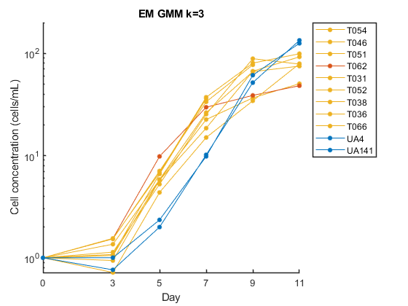
EM GMM k=3
3
3
3
2
3
3
3
3
3
1
1
2

Slide 15
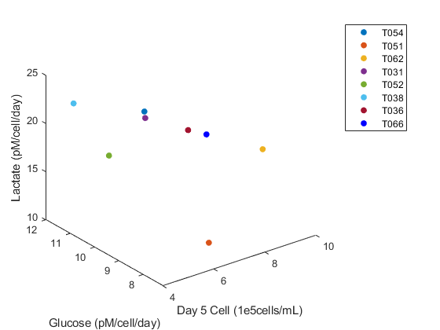
Input data: day 3 and day 5 data
Normalized day 3 cell concentration (not shown)
Normalized day 5 cell concentration
Day 3-5 Glucose uptake rate
Day 3-5 Lactate production rate

Slide 16
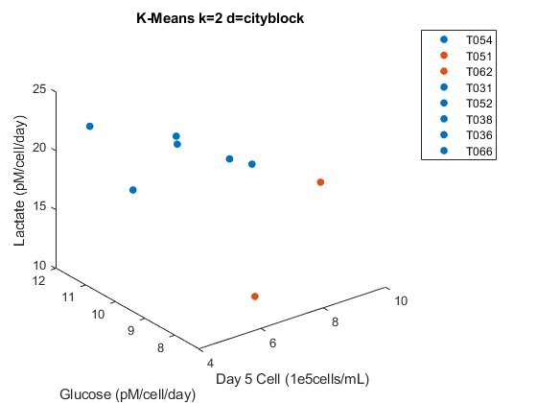
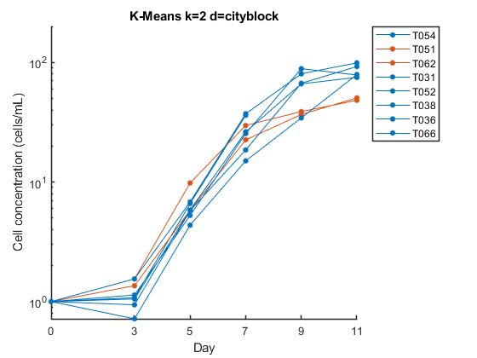
K=means k=2
1
2
2
1
1
1
1
1

Slide 17
Can the results help me select training vs validation sets for the RL environment?
Can the donors of one cluster share a logistic model?

Slide 18
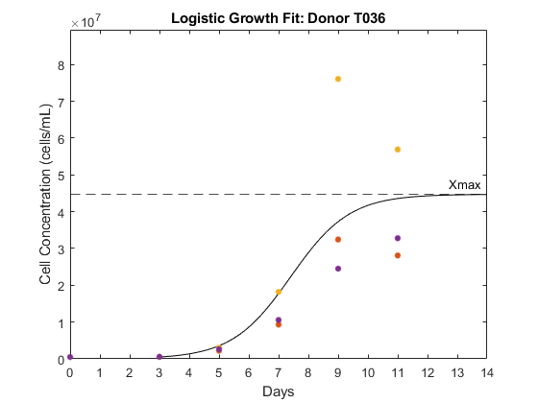
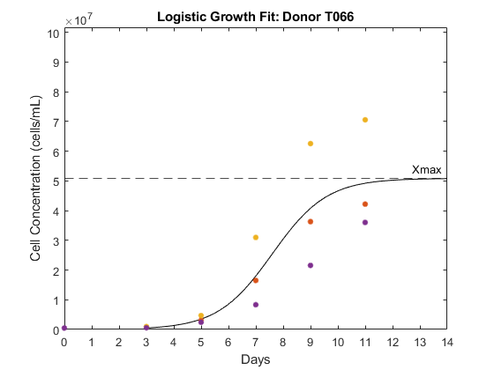
Back to Reinforcement Learning
Donors to include in training set
Should include UA4 and UA141
Should not include UA6
T036 and T066 has extreme outliers (regardless of training set selection)
Agent not making correct decision for UA4 and UA141, despite being trained on UA4 and UA141.

